Slide 2
Object Literals and the Brackets Notation
One can use both dot notation and brackets notation
var car = {}; car.color = "red";car["color"] = "green";
Note that using the brackets notation, I essentially just wrap each property's key as a string,

Slide 3
Arrays are Objects
One of the most commonly used built-in methods on arrays are the push() and the pop() methods fruits.push("apple"); // ['apple']
I can now call the arrayBuilder() function, arrayBuilder('apple', 'pear', 'plum'); // ['apple', 'pear', 'plum’]
Additionally, I can save this function call to a variable. var simpleArr = arrayBuilder('apple', 'pear', 'plum');

Slide 4
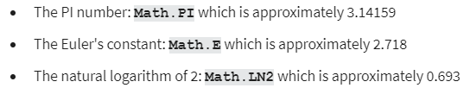
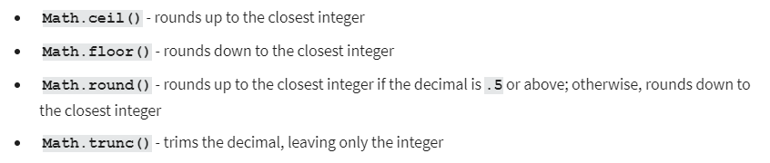
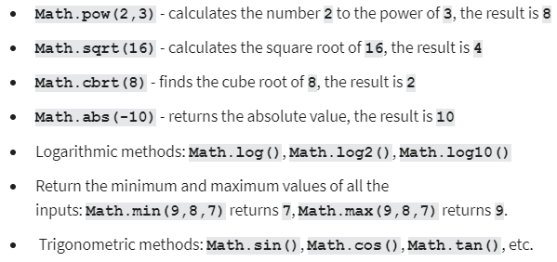
Math object cheat sheet

Slide 5
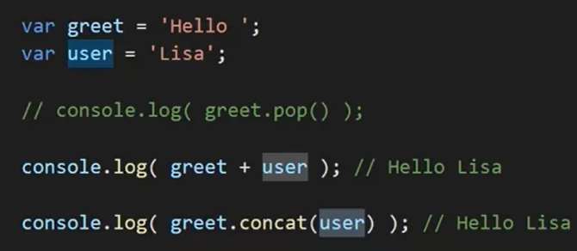
String concatenation

Slide 6
String cheat sheet
var greet = "Hello, ";
var place = "World"
greet.length;
greet.charAt(0); // 'H’
"Wo".concat("rl").concat("d"); // 'World’
"ho-ho-ho".indexOf('h'); // 0
"ho-ho-ho".split("-"); // ['ho', 'ho', 'ho']
greet.toUpperCase(); // "HELLO, "

Slide 7
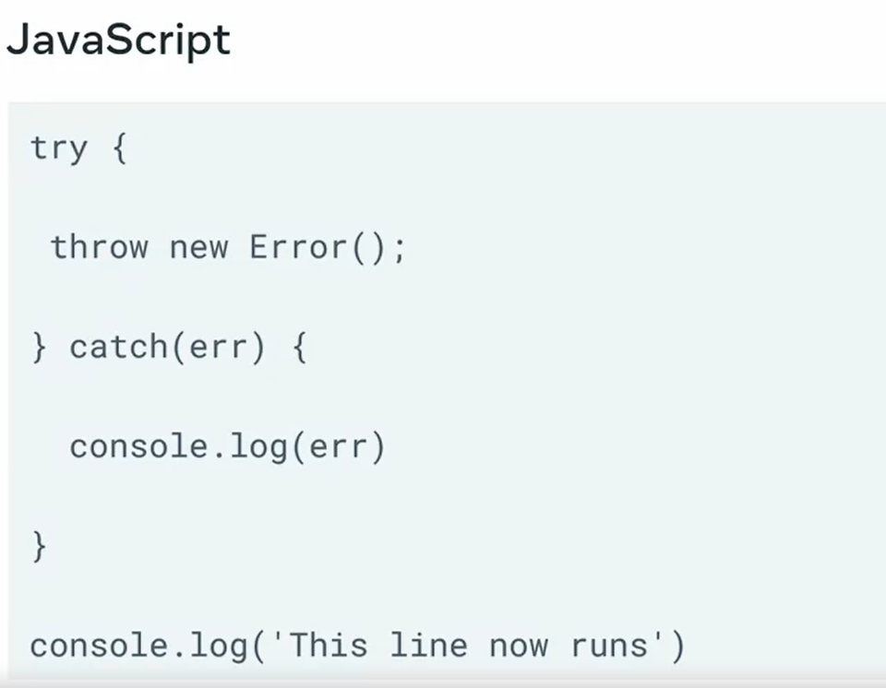
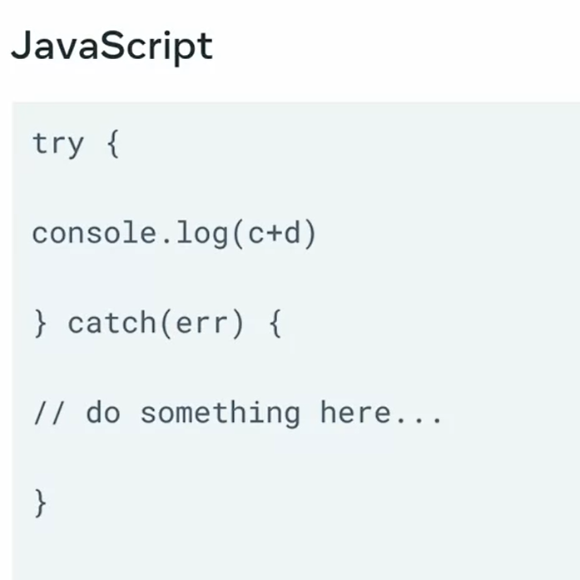
Error handling
Code in try after throw new error will not be executed; it will go to catch instead

Slide 8
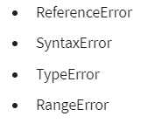
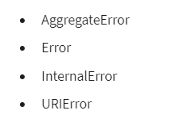

Slide 9
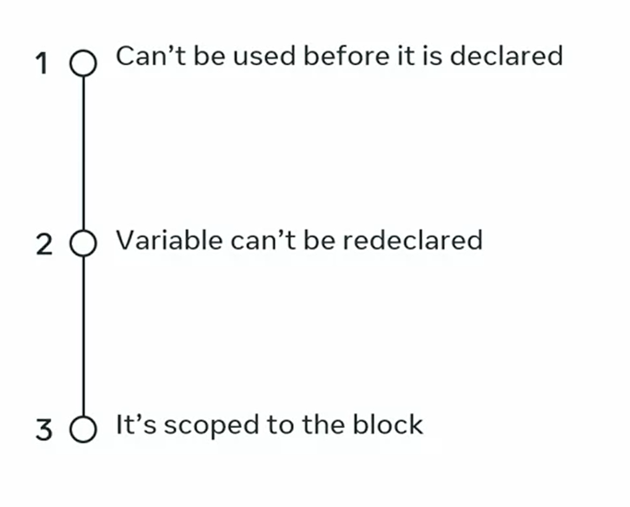
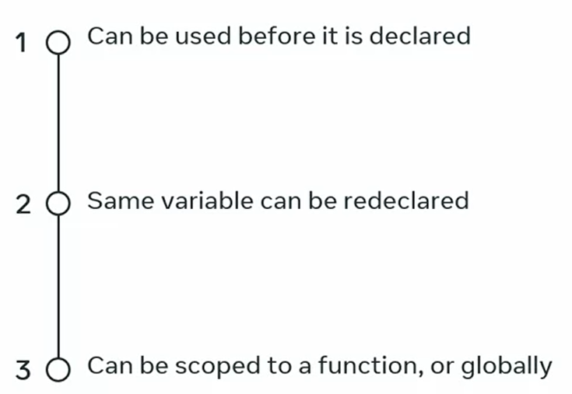
Var let const

